Slide 1
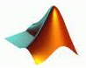







DIGITAL COMMUNICATIONS
Course Code: 23EC2208A
Dr. G V Subbarao
Department of Electronics and Communications Engineering
K L E F Deemed to be University

Slide 2
SYLLABUS
Pulse Modulation Techniques: Baseband signals. Sampling process; Concepts on PAM, PWM and PPM. Quantization Process; Quantization Noise; Linear and Non-linear PCM codes, Noise Considerations in PCM Systems; PCM Line Speed, DPCM, Delta Modulation (DM) and Adaptive DM. Line codes.
Transmission Through Bandlimited Channels: Line Coding; Characterization of Band limited Channels, Optimum Receiver for the AWGN Channel, Detection of Baseband Signals in Noise, Matched filter, Other binary signal transmission and antipodal signals., The Power Spectrum of a Digital PAM Signal, Inter symbol Interference: Eye diagrams, System Design for Band limited Channels. Raised Cosine spectrum, Linear and non-linear Equalizers.
Digital Transmission via Carrier Modulation: Concepts on measure of Information: Bits, Bit Rate, Baud, and M-ary Encoding; Noiseless coding-Huffman coding, Channel capacity, ASK, PSK, FSK, QAM. Bandwidth Efficiency, Carrier and Clock Recovery, Probability of Error and Bit Error Rate, Error Performance.
Spread Spectrum Modulation: Pseudo-noise sequences, notion of spread spectrum, Direct Sequence Spread Spectrum (DSSS) with coherent BPSK, Signal space, dimensionality and processing gain, Probability error and Frequency-Hop Spread Spectrum.

Slide 3
Baseband Pulse Transmission Matched Filter
(Content Prepared by Dr. M. Venugopala Rao, CC)
The term base-band is used to designate the band of frequencies representing the original signal delivered by a source of information

Slide 4
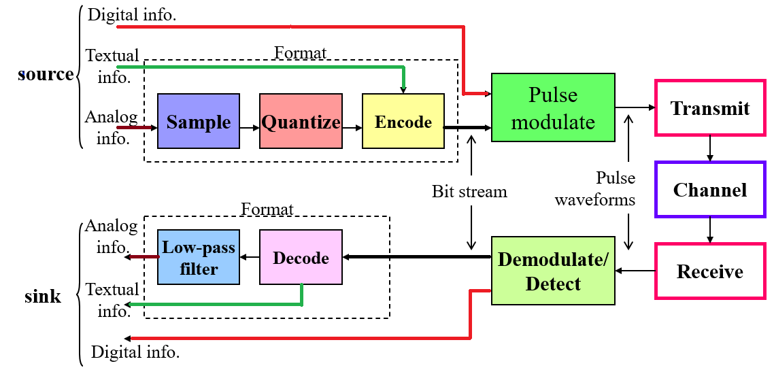
Basic elements of baseband communication system

Slide 5
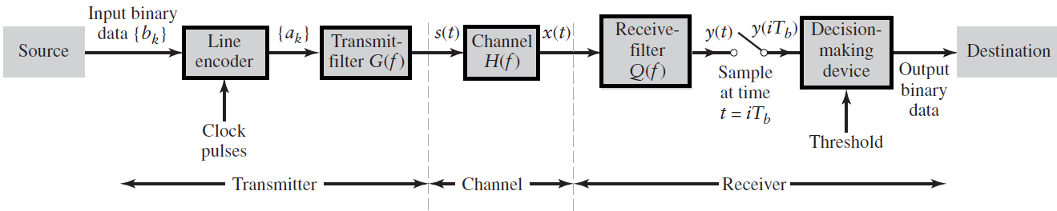
Binary Base-band data transmission System
The term base-band is used to designate the band of frequencies representing the original signal delivered by a source of information

Slide 6
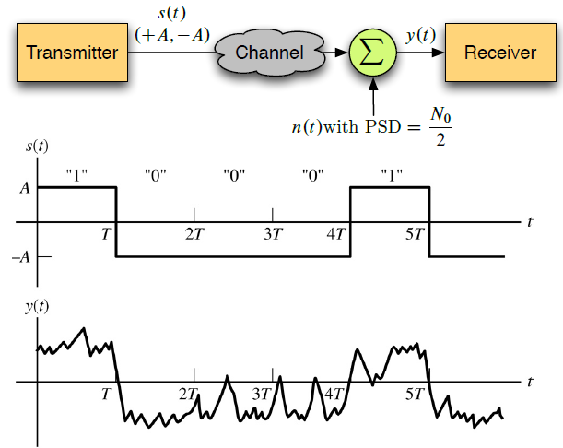
Block diagram of a baseband binary transceiver

Slide 7

Introduction to Matched Filter
The transmission of digital data over a baseband channel is affected by channel noise as illustrated below:
A basic problem that often arises in the study of communication systems is that of detecting a pulse transmitted over a channel that is corrupted by channel noise.
A device (an LTI filter) for optimum detection of a pulse corrupted by noise in the channel is referred to as Matched filter. i.e.,the impulse response of the Matched filter is matched to the pulse signal.

Slide 8
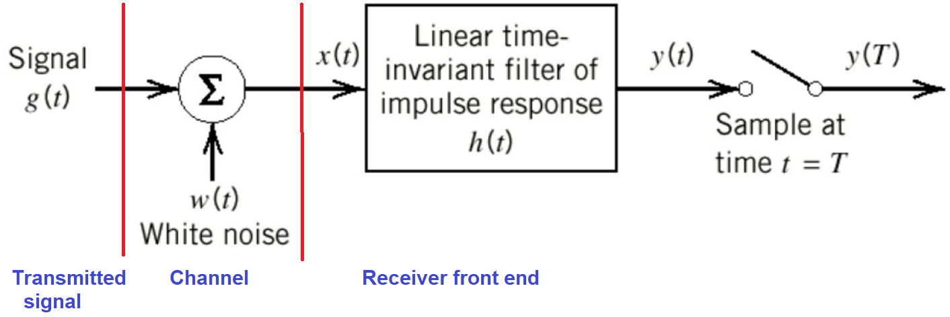
Matched Filter
A matched filter is a linear filter designed to provide the maximum signal-to-noise power ratio at its output. This is very often used at the receiver.
Receiver Model

Slide 9
Consider that the filter input x(t) consists of a pulse signal g(t) corrupted by additive noise w(t) .
It is assumed that the receiver has knowledge of the waveform of the pulse signal g(t).
The source of uncertainty lies in the noise w(t).
The function of receiver is to detect the pulse signal g(t) in an optimum manner, given the received signal x(t).
The purpose of the circuit is to design an impulse response h(t) of the filter such that the output signal-to-noise ratio is maximized.

Slide 10




Slide 11
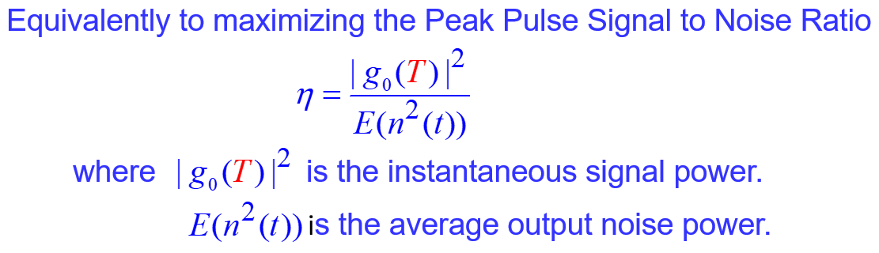

Slide 12
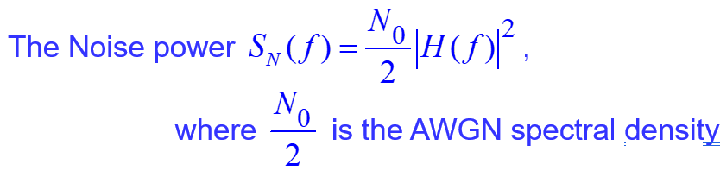
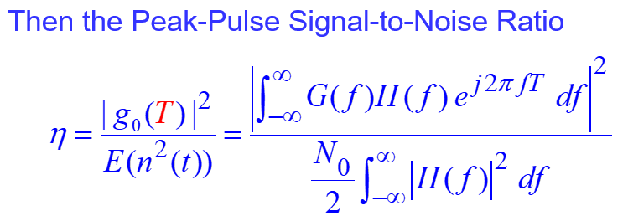

Slide 13
Optimum response of the filter:
To find the solution to this optimization problem, we apply a mathematical result known as Schwarz's inequality to the numerator
On applying Schwartz inequality
Thus SNR is given by
This does not depend on the frequency response H(f) of the filter but only on the signal energy and the noise power spectral density only.
optimum value of

Slide 14

Impulse response of the optimum filter, except for scaling factor k, is a time-reversed and delayed version of the input signal g(t), matched to the input signal.

Slide 15
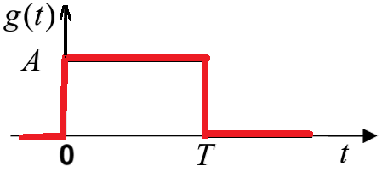
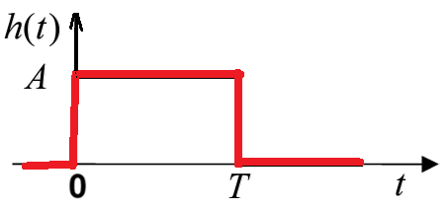
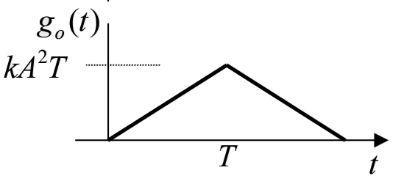
Ex1: Consider a rectangular pulse g(t) shown below. Find and sketch the Matched filter.
Ans:. The Matched filter can be represented by
h(t) = g(T-t) = g(t) and shown below:
The output signal of the matched filter has a triangular waveform as shown.

Slide 16
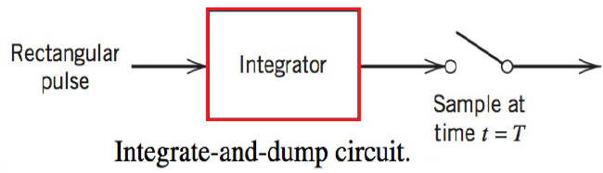
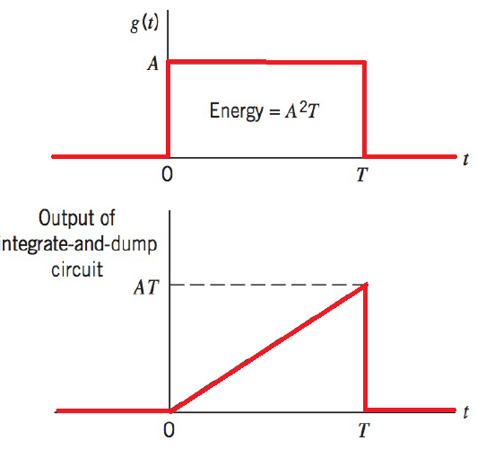
Integrate-and-dump circuit
Ex2: Find and sketch the Matched filter using integrate and dump circuit for Ex1
Ans: The block diagram integrate and dump Matched filter is shown in figure
The integrator computes the area under the rectangular pulse, and the resulting output is then sampled at time t = T, where T is the duration of the pulse.
Immediately after t = T, the integrator is restored to its initial condition; hence the
name of the circuit.

Slide 17
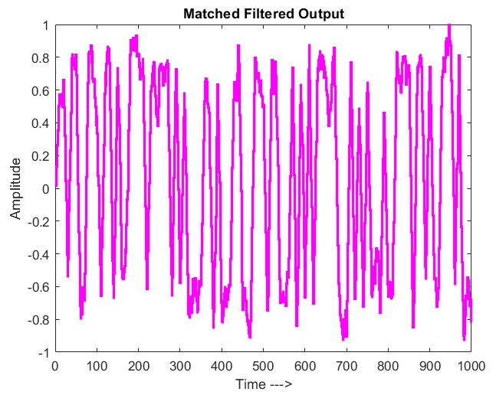
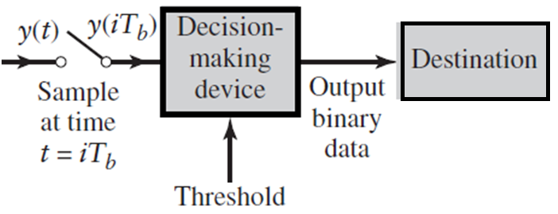

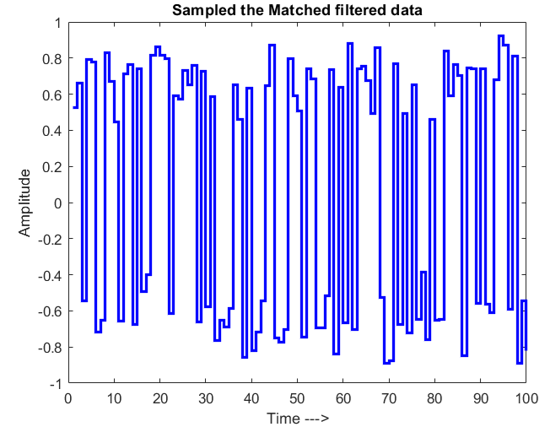
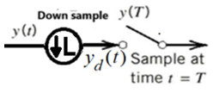
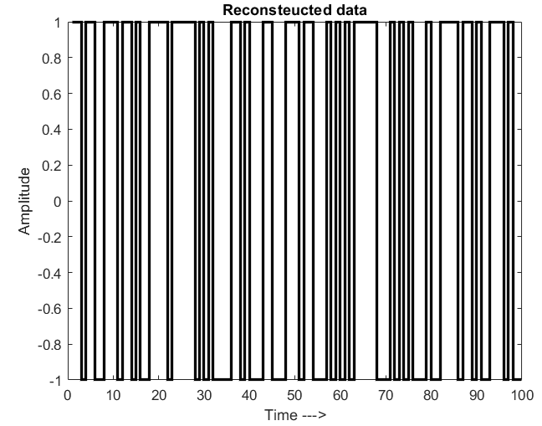
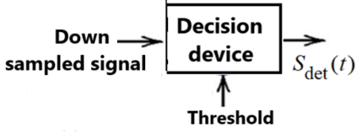
Decision Making

Slide 18
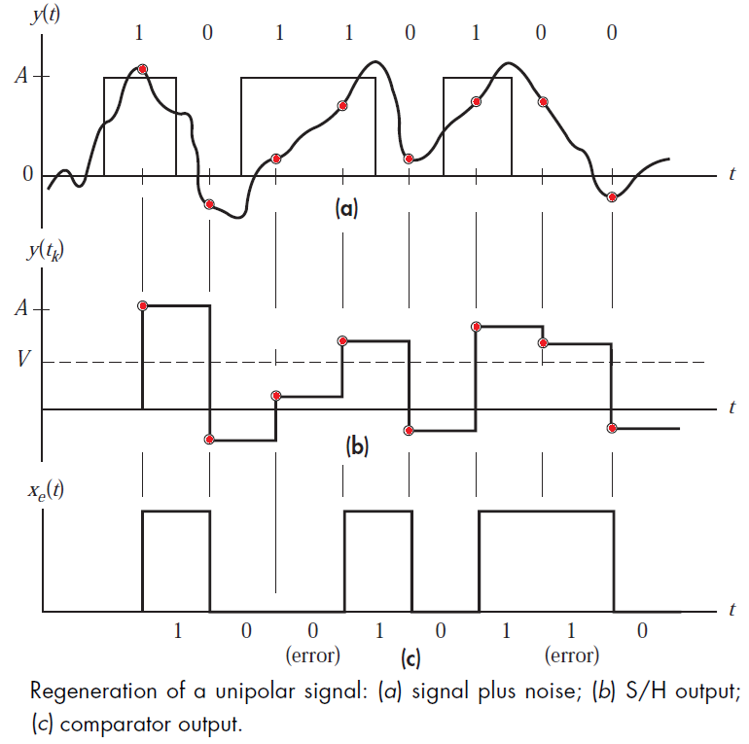
Decision Making
Threshold

Slide 19
Properties of Matched Filter
Property1. A filter matched to a pulse signal g(t) of duration T is characterized by an impulse response that is time-reversed and delayed version of the input g(t):
Property2. A matched filter is uniquely defined by the waveform of the pulse but for the:
- time delay T
- Scaling factor k
Property3: The peak signal-to-noise ratio of the matched filter depends only on the ratio of the signal energy to the power spectral density of the white noise at the filter input.

Slide 20
Inter symbol Interference

